Slide 1
Shell Bootcamp 2024 3 Reflections for Week #1
Shambhavi Vats
Date : 30-Aug-2024

Slide 2
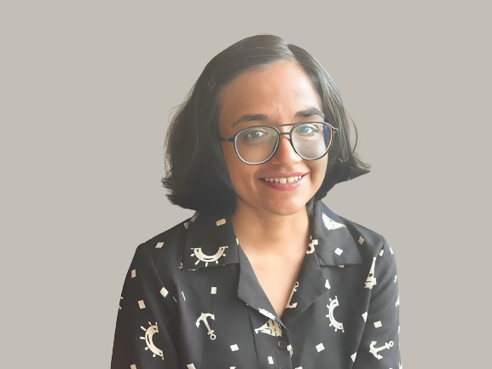
About Me
Decoding the corporate life one algorithm at a time
Please share an image / visual that best represents you

Slide 3

My learnings from this week!

Slide 4
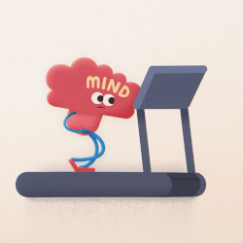
Learning 1 | My takeaways
Importance of growth mindset
Embrace the Challenge
A growth mindset can fuel innovation, and help to drive towards a sustainable future.

Slide 5
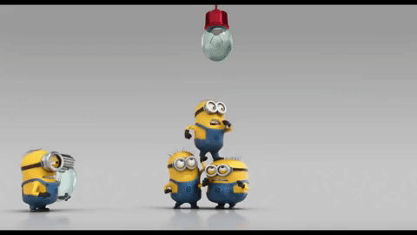
Learning 2 | My takeaways
Importance of Collaboration
Collaboration is the art of aligning diverse perspectives toward a common goal.
In the energy sector, collaboration sparks breakthroughs, uniting diverse expertise to power sustainable progress

Slide 6

Learning 3 | My takeaways
Practicing professionalism
Professionalism is dressing sharp, thinking sharp, and working smart.
In the energy industry, professionalism powers reliability, ensuring that both projects and trust are always fully charged

Slide 7

Relevance of learnings for my organization

Slide 8
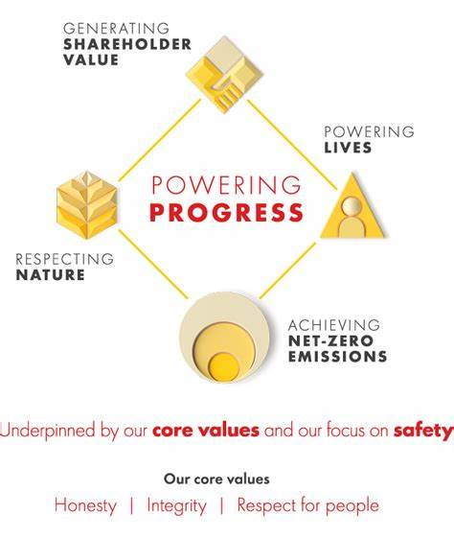
Learning 1 | Relevance for Shell
At Shell, a growth mindset is implanted to, drive innovation and shape a sustainable energy future.
It helps me better align my goals and helps to power progress together.

Slide 9

Learning 2 | Relevance for Shell
Shell implements collaboration by uniting global teams and diverse expertise to innovate and tackle the energy challenges of tomorrow.
It will benefit shell as I will learn to collaboration with global teams and work more efficiently .

Slide 10

Learning 3 | Relevance for Shell
Shell implements professionalism by fostering a culture of integrity, accountability, and excellence in every project and interaction
It will help me start my professional journey with on the right note.

Slide 11

Challenges in implementing learning

Slide 12

Challenge faced while implementing Learning 1
Initially, I felt hesitant to adopt new or out-of-box methods in the professional environment.

Slide 13

Challenge faced while implementing Learning 2
There was initially strong ice between me and all the other new joiners but slowly it started to ace down.

Slide 14
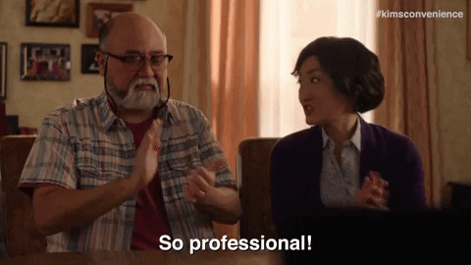
Challenge faced while implementing Learning 3
The corporate world comes with tons of professional etiquettes to function better with cross-functional teams initially I was not fully aware of it .

Slide 15

Action Plan

Slide 16
My Action Plan for this Week
Actions
Timeline
Status
Interacting and Networking with more people.
Thinking of innovative solutions.
Practicing professionalism everyday
I plan to keep working on it consistently
I have successfully networked with more people and implemented innovative solution in my technical workshop

Slide 17

Learning is also Fun!

Slide 18
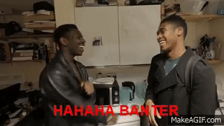
Learning is also Fun!
In a very fun and insightful activity to understand the stakeholders and the powerplay we have a role play with a CEO, government, environmentalists, and clients. The activity was full of banter and power play.

Slide 19

Summary
Learned the importance of soft skills in the professional journey
Next week we will have a full fledge professional technical training.

Slide 20
Thank You

